Slide 1
Manufacture of Paint
AARZOO SIDDIQUI 2012A1PS261G
PREETHAM M S 2012B1A1698G
ARUSHI PANDEY 2012B1A1695G
SACHIN KALAKONDA 2013A1PS761G

Slide 2
INTRODUCTION TO PAINTS
M S PREETHAM

Slide 3
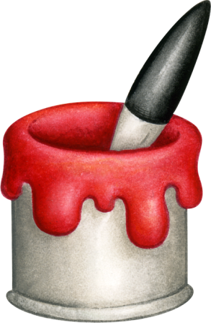
What is Paint?
A paint is a Solution or suspension of pigment, binder and mineral solvent.
Thin dry film formed by this Solution is then applied to a surface which is used as a decorative or protective coating.
Paint was first used as a protective coating by the Egyptians and Hebrews, who applied pitches and balsams to the exposed wood of their ships.
But today, its usage is not just limited to protection but it is also widely used for its appeal.

Slide 4

Paint is used to protect, preserve, decorate, or add functionality to an object or surface by covering it with a pigmented coating.
An example of protection is to retard corrosion of metal.
An example of decoration is to add festive trim to a room's interior.
An example of added functionality is to modify or heat radiation of a surface. Also the use of color to identify hazards or to identify the function of equipment and pipelines.

Slide 5
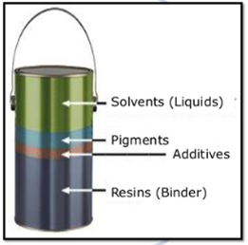
COMPOSITION OF PAINTS
PIGMENT
BINDER
SOLVENT
ADDITIVE

Slide 6
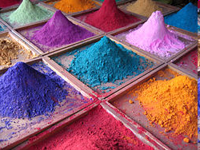
PIGMENTS
Granular solids incorporated in the paint to contribute color.
Pigments can be classified as natural and synthetic types.
Pigment results into a
suspension whereas dye
results into a solution.
White Pigment : Titanium Dioxide
Black Pigment : Carbon Black

Slide 7
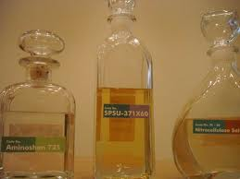
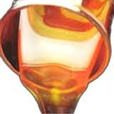
BINDER
The binder, or resin, is the actual film forming component of paint.
Binders are chosen according to the paint properties required and can thus greatly affect the ability of the paint to withstand the weather, wear and tear.

Slide 8
SOLVENTS
Mostly volatile and has low viscosity.
Includes petroleum mineral spirits and aromatic solvents such as benzol, alcohols, esters, ketones, and acetone.
Controls flow and application properties, and affect the stability of the paint while in liquid state.

Slide 9
ADDITIVES
They serve as everything from fillers to anti-fungicidal agents. Additives serve many purposes. Some, like calcium carbonate and aluminium silicate, are simply fillers that give the paint body and substance without changing its properties.
Others produce certain desired characteristics in paint, such as the thixotropic agents that give paint its smooth texture, driers, anti-settling agents, anti-skinning agents, defoamers, and a host of others that enable paint to cover well and last long.

Slide 10
Design
Paint is generally custom-made to fit the needs of industrial customers.
Paint intended for the consumer can also be custom-made. Paint manufacturers provide such a wide range of colours that it is impossible to keep large quantities of each on hand.
To meet a request for "aquamarine," "canary yellow," or "maroon," the manufacturer will select a base that is appropriate for the deepness of colour required.

Slide 11
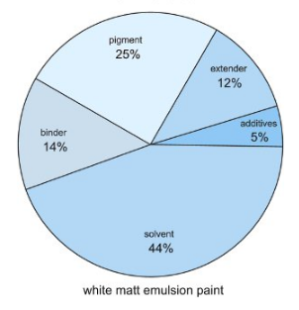
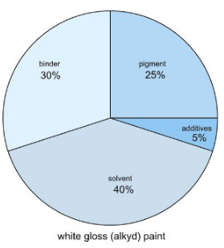
Pastel paint bases will have high amounts of titanium dioxide, the white pigment, while darker tones will have less.
Then, according to a predetermined formula, the manufacturer can introduce various pigments from calibrated cylinders to obtain the proper colour.

Slide 12
Types of Paints
Primers : They are basecoats applied to a surface to improve the adhesion of subsequent coats of paints and ensure durability.(RED OXIDE)
Enamel Paint : Dries to an especially hard, usually glossy, finish.
Contain either glass powder or tiny metal flake fragments instead of the color pigments found in standard oil-based paints.
Enamel paint is also mixed with varnish to increase shine as well as assist its hardening process

Slide 13
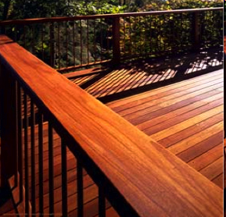
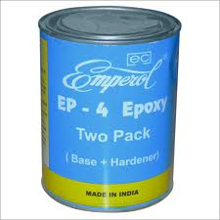
WOOD STAIN
Thin, Low viscosity.
EPOXY STAIN
High quality, two- component, epoxy-polyamide system.

Slide 14
Paint Classification
Architectural Paints : These are air drying materials applied by brush or spray to architectural and structural surfaces and forms for decorative and protective purposes.
Commercial Paints : Air drying or baking cured materials applied by brush spray to kitchen and laundry appliances, automobiles, machinery etc
Industrial Paints : It is subdivided by their intended service. Corrosion resistant coatings, high temperature coatings and coatings for immersion service.

Slide 15
PROCESS FLOW SHEET
ARUSHI PANDEY

Slide 16
Failures of Paints
Dilution
Contamination
Cracking
Erosion
Peeling

Slide 17
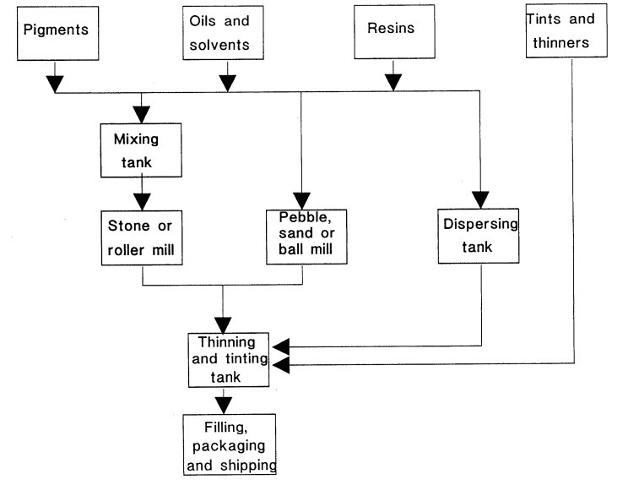
Simple Block Diagram

Slide 18
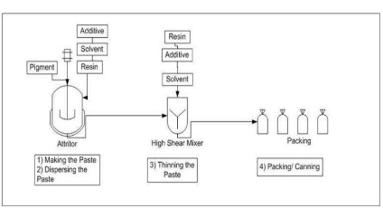
Simplified FlowSheet

Slide 19
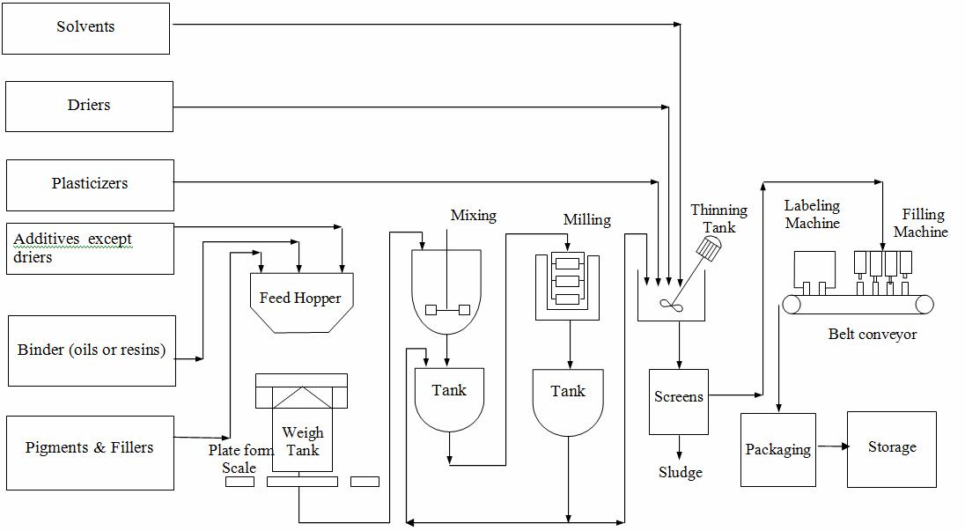
Flow Sheet

Slide 20
Manufacturing Process
Ingredients are typically measured by weight on scales, and in some cases even by volume.
Making the paste
After all the ingredients are mixed they are sent to the mixer, where the initial ingredients are mixed thoroughly. The main purpose of this is to obtain a uniform paste and to wet the pigments with the vehicle. This is done until we receive a smooth and uniform mixture. Here the pigment is gradually added to the vehicle.
Milling/ Grinding
The paste mixture for paints is routed into a sand mill, a large cylinder that agitates tiny particles of sand or silica to grind the pigment particles, making them smaller and dispersing them throughout the mixture. The mixture is then filtered to remove the sand particles.

Slide 21
Thinning the paste
The paste is now to be thinned to produce the final product. In this process we add oils driers and thinners. The consistency of the paste is reduced by this gradual addition of liquids with simultaneous mixing. Transferred to large kettles, it is agitated with the proper amount of solvent for the type of paint desired.
Tinting
The colors previously ground in the oil are added in small portions to the batch and then to the complete batch and stirred well to ensure uniform distribution.
After this step we send the sample to the lab for approval

Slide 22
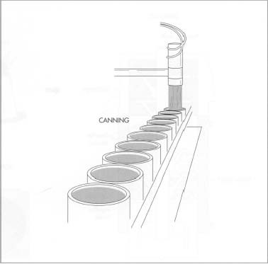
Straining and Canning the paint
The batch is passed through a series of filters to remove any foreign particle that might be present. The finished paint product is then pumped into the canning room. A certain number of cans (usually four) are then boxed and stacked before being sent to the warehouse.

Slide 23
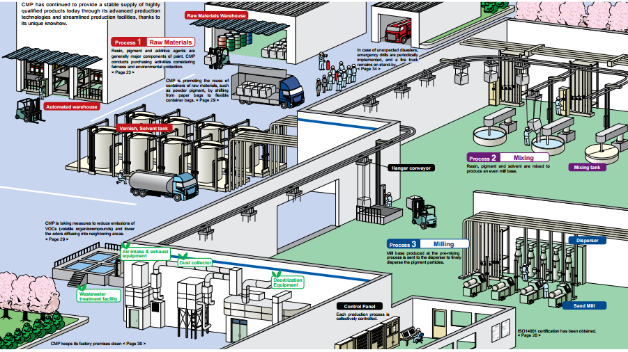

Slide 24
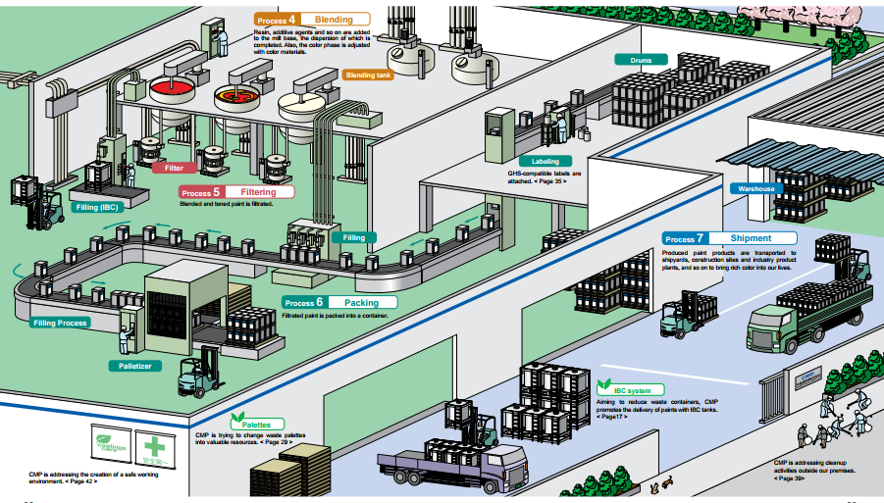

Slide 25
Sample Testing
First Lab Sample : The first lab sample is taken from the first portion of the batch through the grinding operation. Here, the fineness of the grind is measured.
Second Lab Sample : The second sample is taken after the thinning and tinting operation. This sample is tested for gloss, hiding power, color, consistency, brush ability, weight per gallon, drying time, leveling.

Slide 26
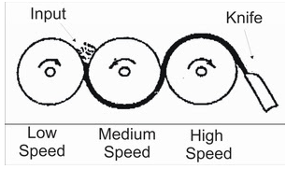
Machinery Used
Mixers : The mixer normally has a vertical tank with an impeller driven by an electric motor. Axial propellers are the most common in the paint industry. They are used to achieve homogeneity.
Mills: The most common type of mills used in this industry are roller mills or ball mills. In larger factories sand mills or dyno mills are used.
This is roll mill with three rollers arranged one after the other, and they all rotate in different directions with a speed in the ratio of 1:3:9

Slide 27
MACHINERY USED
Sachin kalakonda

Slide 28
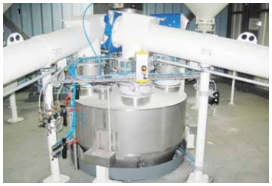
Powder conveying screws on metering hopper
Conveyor Engineering & Manufacturing ,USA
Supreet Engineers Private Limited, PUNE
Neelam Industries,Ahmedabad
http://scrubbersandbagfilters.com/

Slide 29
Advantages
Minimizes Product Breakage and Degradation.
Combines Bi-directional Transport with Multiple Inlets and Discharges in One System.
Standard Construction Provides a Dust-Tight and Air-Tight Environment.
Sanitary Ultra High-Strength Hardened Alloy or Stainless Steel Chain.
Very low bulk density material can be handled

Slide 30
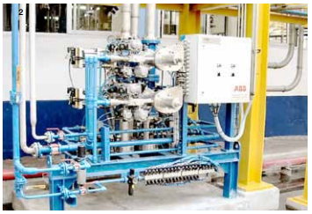
Piggable manifold with pig loading stations.
FMC Technologies,USA
Wei-Pack Engineering Pvt. Ltd. MUMBAI
http://www.fmctechnologies.com/

Slide 31
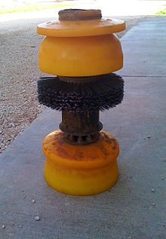
PIG ELEMENT

Slide 32
Minimize product loss.
Avoid product contamination and hence increased product quality.
Minimal capital investment in fabrication of pipelines in process plants.

Slide 33
Reduced plot space requirements.
Fully Automated system and hence ease of operation.
Lower Operating cost.
Enhanced safety of plant, personnel.
Improved environment cleanliness

Slide 34
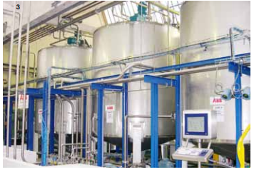
Storage tanks
Omkar India Private Limited,Gujarat.
Federal Equipment Company,USA

Slide 35
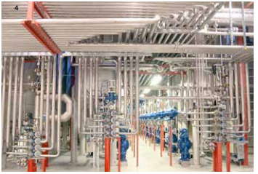
Piggable Collectors
FMC Technologies,USA
Wei-Pack Engineering Pvt. Ltd. MUMBAI

Slide 36
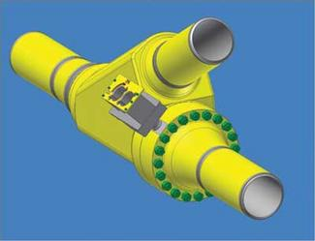
Advantages
Precisely dose liquid materials through mass-flow meters .
A piggable wye is a Y-shaped fitting that has two inlets, one for each incoming pipeline, and a single outlet that merges the flow of the two converging pipelines.

Slide 37
Environmental Concerns
A recent regulation concerning the emission of volatile organic compounds (VOCs) affects the paint industry, especially manufacturers of industrial oil-based paints.
It is estimated that all coatings, including stains and varnishes, are responsible for 1.8 percent of the 2.3 million metric tons of VOCs released per year.
The new regulation permits each litre of paint to contain no more than 250 grams (8.75 ounces) of solvent.

Slide 38
Effects on the environment
When VOC’s react with oxygen, they can form ‘bad’ ozone in the presence of sunlight.
This is a contributory factor to the greenhouse effect and a cause of global warming.
One study by C.E.P.E. attributes paints and varnishes to causing as much as five percent of all VOC emissions.

Slide 39
Toxic Boat Paint
Paint used to deter limpets, mussels, and other sea organisms from sticking to the bottom of boats has been labelled as the most toxic substance ever to be unleashed on the marine environment.
Tributyltin - or TBT – was condemned as much as forty years ago when its harm as an endocrine-disrupter were first noted.
Since then, it has done untold harm to such sea creatures as oysters, harbour porpoises, mussels, clams, abalone, gastropods, and skipjack tuna, as well as generally polluting the sea.

Slide 40
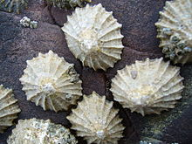
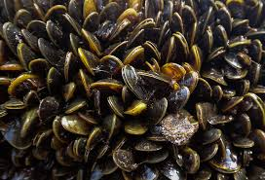
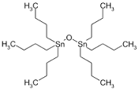
Limpets
Mussels
TriButyltin

Slide 41

Although concern over tributyltin has been shared by countries the world over and its use is mainly restricted to unscrupulous practitioners, ratification of a ban has been slow to take effect.
However, from 2008 the use of TBT will finally be outlawed in Europe and any boats or ships entering EU waters using TBT will be turned away.

Slide 42
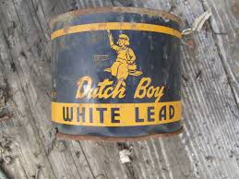
Lead based Paints
Paint with lead additives is still manufactured and sold in many areas of the world. Lead or lead compounds may have been added by the manufacturer to give paint its color, to allow the paint to reduce cor­rosion on metal surfaces, or to help the paint dry more quickly.
Lead compounds may also be present in other coatings such as varnishes, lacquers, stains, enamels, glazes or primers. However alternatives to lead exist that are currently available on the market to paint manufacturers.

Slide 43
Waste Water Treatment
A large paint manufacturer will have an in house wastewater treatment facility that treats all liquids generated on-site.
The liquid portion of the waste is treated on-site to the standards of the local publicly owned wastewater treatment facility; it can be used to make low-quality paint.
Latex sludge can be used as fillers in other industrial products.
Waste solvents can be recovered and used as fuels for other industries.

Slide 44
Future Aspects
ARZOO SIDDIQUI

Slide 45
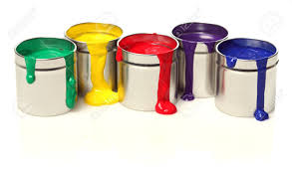
Quality Control
Paint manufacturers utilize an extensive array of quality control measures. The ingredients and the manufacturing process undergo stringent tests, and the finished product is checked to ensure that it is of high quality. Some common properties that determine its quality are
Consistency
fineness of grind
Color
hiding power
Brush ability
Durability
drying time

Slide 46
Fineness of Grind : To measure the fineness of grind a grind gauge is used. A sample of paint is placed at the deep end of the channel and drawn down the block with a scraper. Holding the block horizontal in the plane of the eye, the point where coarse particles appear on the surface of the paint indicates the fineness of grind.
Consistency : This property of paint is measured by an apparatus consisting of a paddle connected by a pulley system to a falling weight. The consistency is measured by the tiime required for 200 revolutions of the standard paddle imersed a given distance in the paint at a constant temperature of 250C
Notes:
which consists of a hard steel block with a wedge shaped channel i inch wide and ranging from zero to 0.005 inches deep. A linear 1A scale is imprinted along the side of the channel rangi-ng from 0 at a point 0.004 inches deep to 8 at zero. The length of the channel is 5 inches.

Slide 47
Durability: The durability of a paint is assessed by preparing painted panels. These are exposed to the weather for extended periods of time The durability of the paint is then evaluated by its resistance to fading, cracking, peeling, erosion mildew and moisture failure.
Drying Time : The time required for a paint to dry is determined by spreading a sample on a glass plate placed vertically in a well ventilated room and making a qualitative measurement of time required to dry as determined by a finger touch of the surface.

Slide 48
Hiding Power : A brushout on a panel composed of a checkerboard of white and black spaces is used to judge the relative hiding power of a paint.
Paint is then applied to a surface and studied for bleed resistance, rate of drying, and texture.
In terms of the paint's aesthetic components, colour is checked by an experienced observer and by spectral analysis to see if it matches a standard desired colour.
Resistance of the colour to fading caused by the elements is determined by exposing a portion of a painted surface to an arc light and comparing the amount of fading to a painted surface that was not so exposed.

Slide 49
Market Analysis
The market for paints in India is expected to grow at 1.5 times to 2 times GDP in the next five years.
The market size of the paint industry in India is estimated at around Rs 350 bn. Industry players expect close to 12% growth in business volume and 10-12% rise in sales in FY16.
Decorative paints segment is expected to witness higher growth going forward. The fiscal incentives given by the government to the housing sector have immensely benefited the housing sector. This will benefit key players in the long term.
Although the demand for industrial paints is lukewarm it is expected to increase going forward. This is on account of increasing investments in infrastructure.

Slide 50
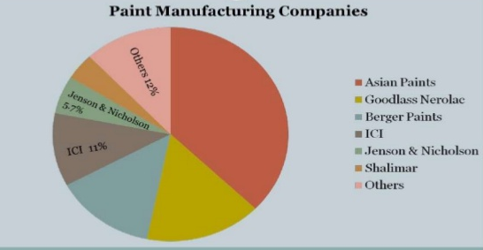
Paint Industry in India

Slide 51
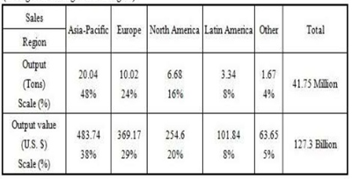
Global Scenario of Paint
The Asia Pacific is still the world’s largest paint consumer. China accounts for more than half of this consumption

Slide 52
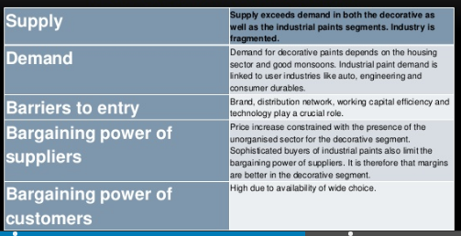
Paint Market Analysis

Slide 53

Thank You

